Slide 1
Hypothesis Testing
By : L Vinay Rajiv Reddy

Slide 2
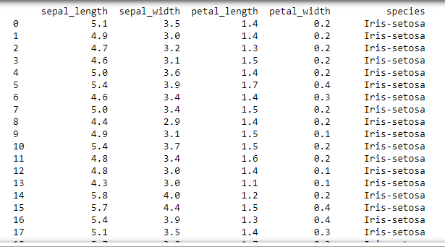
What is hypothesis testing ?
Data alone isn’t enough.
Interpretation from the data does matters.

Slide 3
Data Set : Popular Trains in SCR
NAME TYPE DIVISION DISTANCE TRAVELLED
Palnadu Exp. Guntur 350KM
Kakatiya Pass. Sec-bad 128KM
Pinakini Exp. Vijayawada 399KM
Golconda Exp. Guntur 458 KM
LPI – BZA Exp. Vijayawada 349KM
Repalli Pass. Guntur 401KM
Narayanadri Exp. Guntakal 676KM
SC – GNT Exp. Sec-bad 458KM
Cocanada Exp. Vijayawada 652 KM
NDKD - MCL Pass. Guntur 35KM

Slide 4
Hypothesis – Investigation from the data
H0 – Null hypothesis
H1 – Alternative hypothesis
Mutually Exclusive Events
Eg:
1) H0: India is going to win 99 medals in upcoming Tokyo Olympics.
H1: India is not going to win 99 medals in upcoming Tokyo Olympics.
2) H0: Guntur Division has more no. of popular trains.
H1: Guntur Division doesn’t have more no. of popular trains.
3) H0: Vijayawada is the only division to have all Express trains.
H1: Vijayawada is not only division to have all Express trains.

Slide 5
STEPS:
1) Initial Assumption.
2) Collecting the evidences (population sample ).
3) Analyzing to reject NULL or not. (based on P value )
4) If null is proven to be false, we go for H1.

Slide 6
How to perform
While analyzing the data/ evidences, we obtain P Value/ Significant value.
If p<=0.05 ( Reject H0)
Else consider H0
Methods to perform :
1) Chi Square Test
2) T Test
3) Anova Test

Slide 7
If (2 Categorial Features ) ➔ Chi Square Test
If (1 Categorial Features and 1 Continous Features) ➔ T Test
If ( Categorial data having more than 3 unique values ) ➔ Anova Test
Errors:
1) Type -1 Error :
If H0 was rejected by analysis, but indeed it’s only true
2) Type–2 Error :
If H0 is analyzed as True, but indeed it’s not true.

